Slide 1
Tips Shared during the class
Iman Mossavat

Slide 2
Item
Visualize
Ask What-if questions
Do not trust a single metric
Build more than one model
Go beyond default values

Slide 3
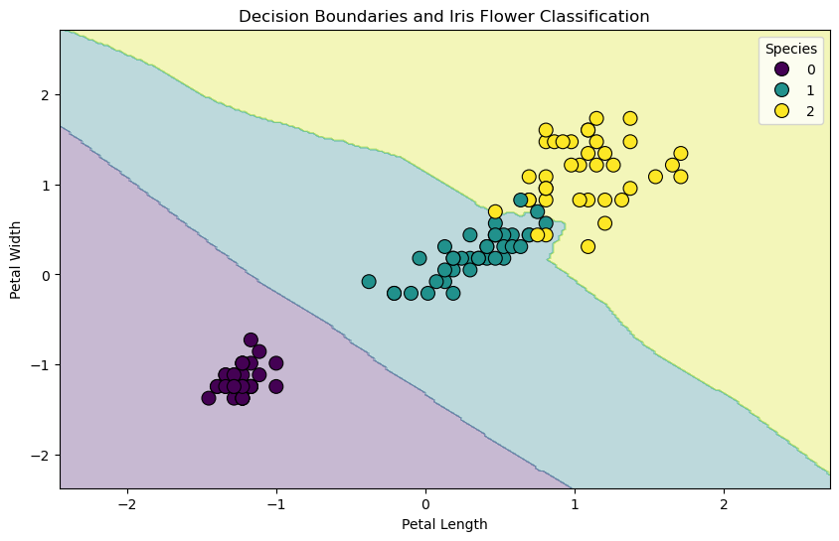
Visualize
How: Scatterplots of features vs. target, Histograms of features, target. Scatterplots, histograms, residual plots, decision boundaries (classification), or response surfaces (regression)
Why: Help you understand if your choices are appropriate (see the slide on do not trust single metric)

Slide 4
Ask What-if questions
What happens if I change a feature?
Do income predictions change if we change gender or age? See examples here where changing one feature changes the outcome
AI, Explanations & Fairness with Census Income Data.ipynb - Colab
Asking what-if questions helps us understand if the model is finding meaningful associations (think of correlation vs. causality.)

Slide 5
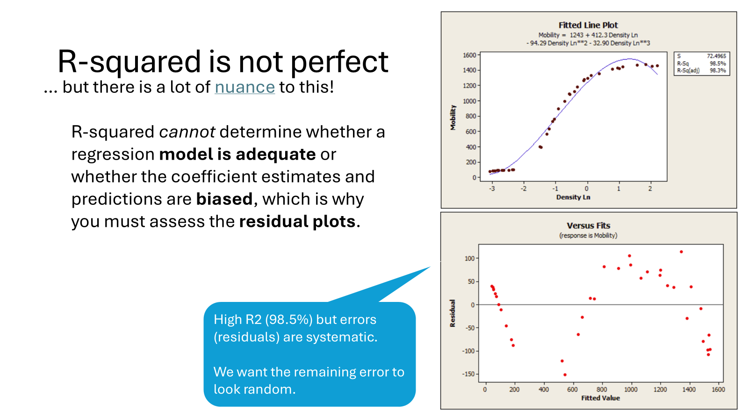
Do not trust a single metric
Metrics only show one perspective; you need multiple views to understand what is going on.
Example: you can have high R2 but if plot the residuals you can see that you are missing something.

Slide 6
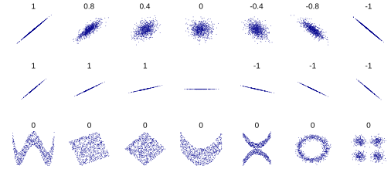
Do not trust a single metric
Metrics only show one perspective; you need multiple views to understand what is going on.
Example: Deciding on the feature selection purely based on correlation can be wrong.
The correlation between X and Y is 0 in the lower panel, but these variables do depend on each other! If you know X, if will tell you something about Y.

Slide 7
Always compute the score on BOTH training and test data sets
Compute the accuracy, or R^2 on both training and test.
Plot the residuals on both training and test.
…
If the algorithm works well on training but poorly on testing, it is overfitting!
You need to see BOTH numbers.

Slide 8
Build more than one model
How: Feature selection, model class (linear, SVM, KNN), build a comparison table. Reflect on possible reasons, iterate if needed.
Why: You can investigate your modeling assumptions and verify your design choices, establish a baseline
- This goes beyond ML! Never depend on a single set of assumptions

Slide 9
Always think about overfitting and underfitting
In our examples we often use the model with its default settings. Model parameters change their performance significantly.
Find which knob controls the function complexity:
The number of neighbors in KNN
Alpha in Ridge regression or Lasso
Read the documentation for each model you see

